Slide 1
Retail Sales
&
Inventory Intelligence System
- Rohith Malleboena

Slide 2
Project Objective
A comprehensive data analysis solution for a retail company that the company’s management seeks to extract insights that can:
- Improve sales strategies
- Understand customer preferences
- Identify top-selling products
- Optimize inventory
- Monitor staff performance.

Slide 3
Project Flow
Phase 1: Excel – Data Preprocessing
Phase 2: SQL – Database Management and Querying
Phase 3: Power BI – Dashboard Creation

Slide 4
1: Excel – Data Preprocessing
Loaded raw data into Excel.
Cleaned up inconsistencies.
Normalized specific fields.
Saved clean datasets for import into SQL.

Slide 5
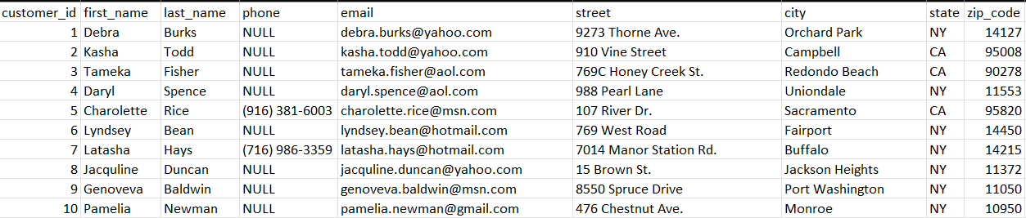
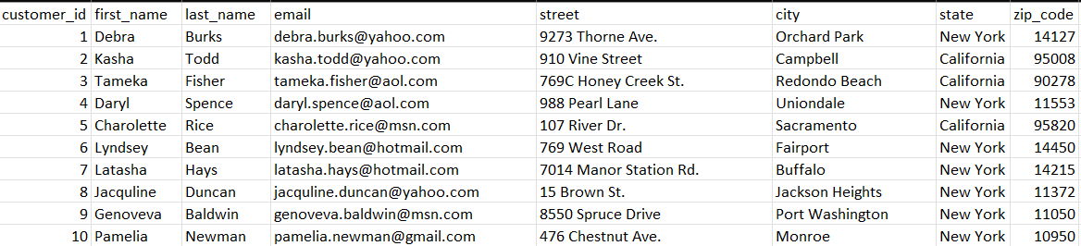
Raw Data: Customers Table
Prepared Data : Customers Table

Slide 6
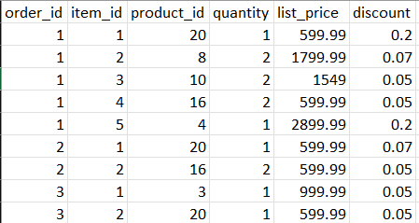
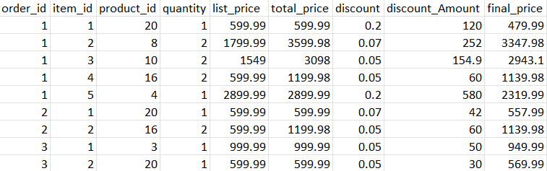
Raw Data: Order Items Table
Prepared Data : Order Items Table

Slide 7
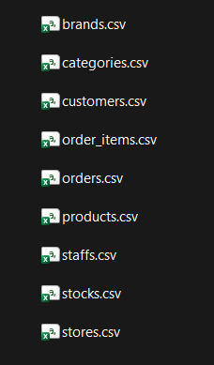
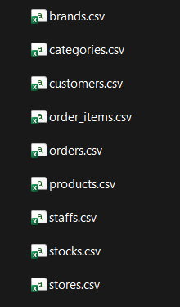
RAW DATASETS
PREPARED DATASETS
DATA CLEANING

Slide 8
2: SQL – Database Management Querying
Created the database.
Imported prepared datasets into MySQL.
Built relations between by using ER Diagram
Created Multiple Views.

Slide 9
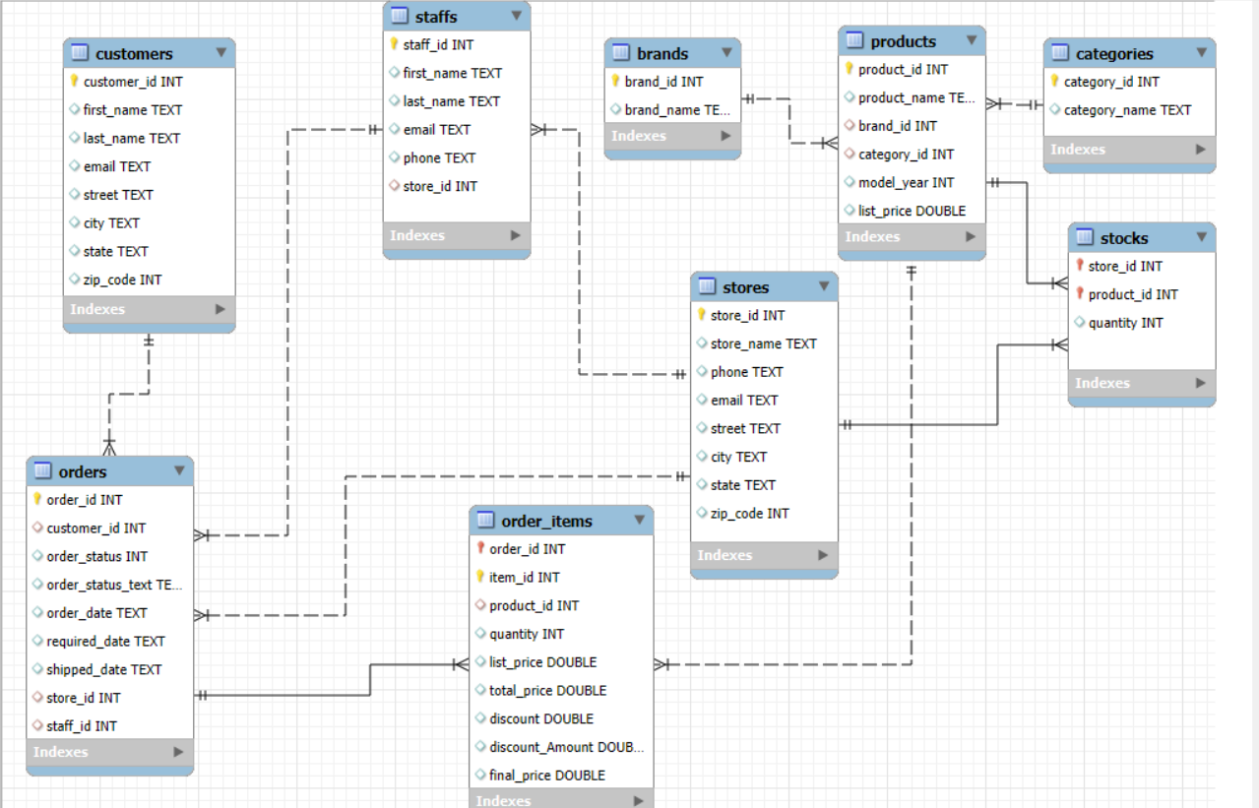
Structure of Tables and ER Diagram

Slide 10
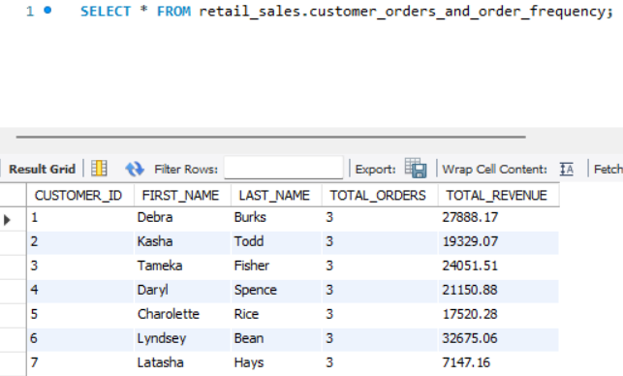
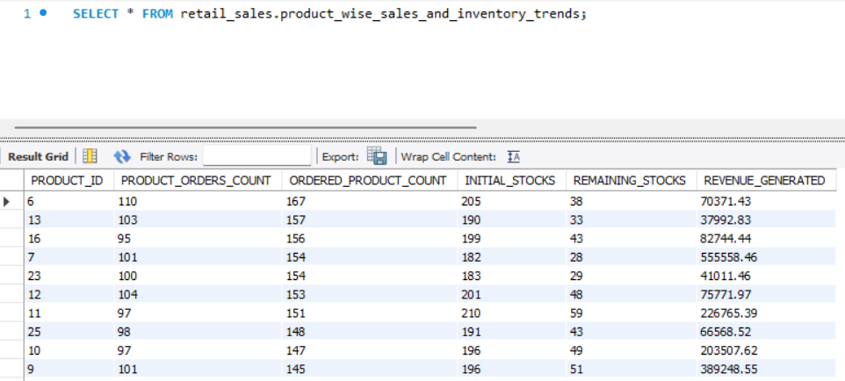
Created Multiple Views
SELECT * FROM retail_sales.customer_orders_and_order_frequency;
SELECT * FROM retail_sales.product_wise_sales_and_inventory_trends;

Slide 11
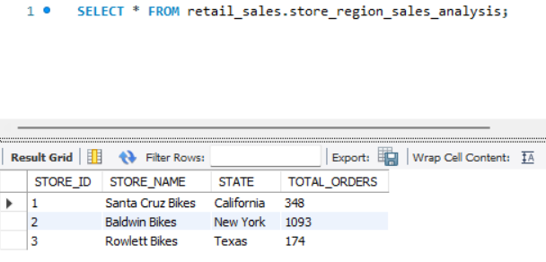
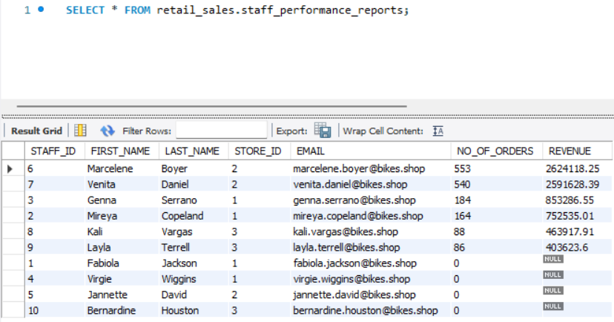
SELECT * FROM retail_sales.store_region_sales_analysis;
SELECT * FROM retail_sales.staff_performance_reports;

Slide 12
3: POWER BI – DASBOARD CREATION
Connected Power BI to SQL Database
Built reports for
  Staff and Store wise Sales Analysis.
  Customers Orders & Order Frequency.
  Product Sales and Inventory Trends.
Findings, Insights and Recommendations

Slide 13
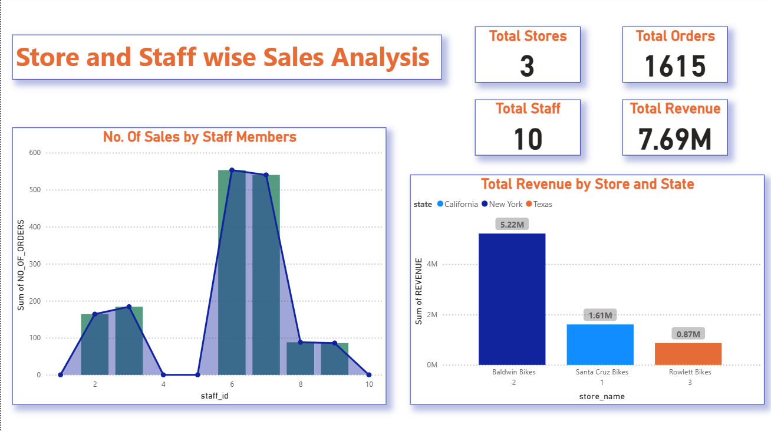
Findings And Insights
Baldwin Bikes (New York) leads with ₹5.22M (≈68%) of total revenue, followed by Santa Cruz Bikes (₹1.61M) and Rowlett Bikes (₹0.87M).
Some staff members show zero sales contribution, indicating performance disparity.

Slide 14
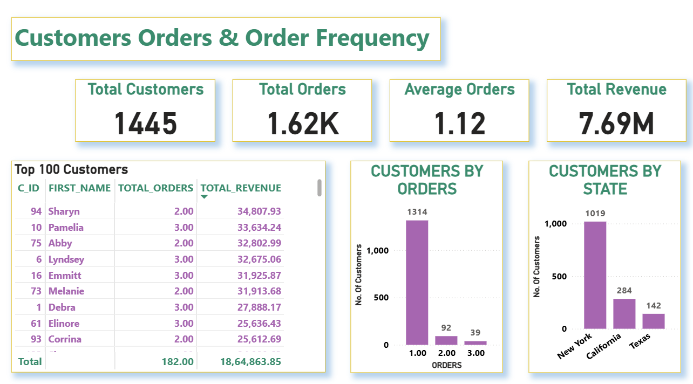
Findings And Insights
91% of customers (1,314) made only one purchase, reflecting low repeat order behavior.
The Top 100 customers generated ₹1.86M revenue, showing that a small fraction of customers contribute a significant portion of total sales.

Slide 15
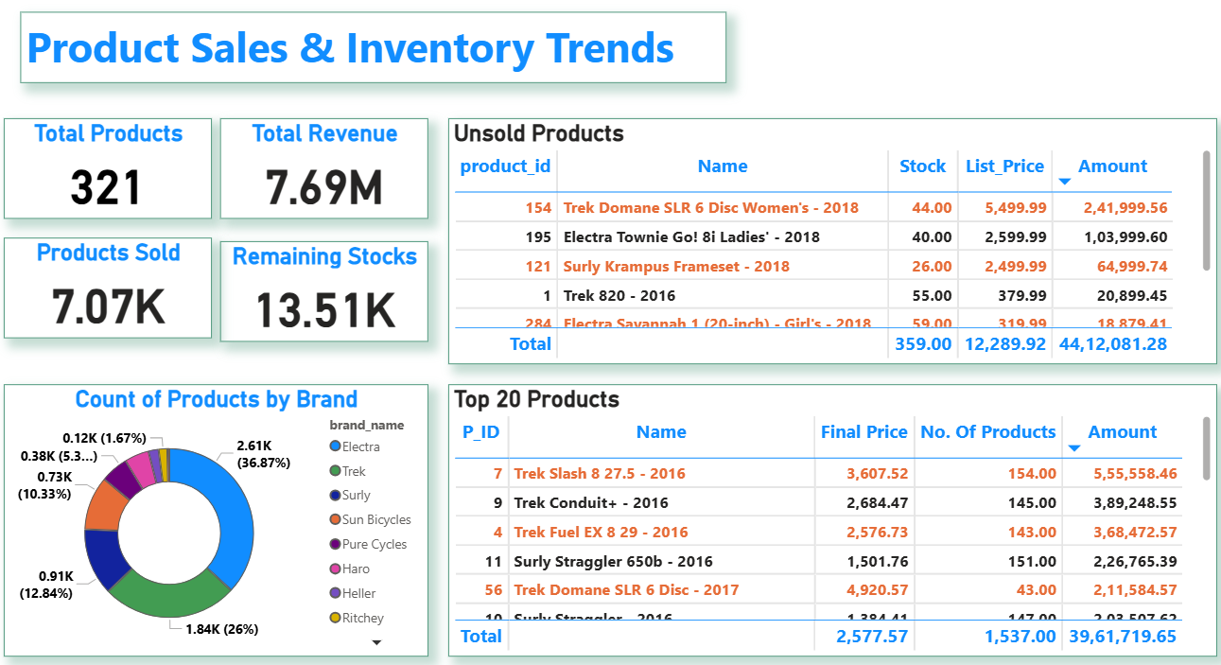
Findings & Insights:
The Electra brand leads product share with 36.87%, followed by Trek (26%) and Surly (12.84%).
Several products remain unsold, valued at ₹4.41L, indicating low demand.
The Top 20 products contribute ₹3.96M (over 50% of revenue), emphasizing dependence on a few bestsellers.

Slide 16
Recommendations:
Introduce staff performance incentives and training programs to balance sales.
Strengthen sales and marketing strategies California and Texas to improve store-level revenue share.
Launch loyalty or reward programs to improve repeat purchase rates.
Focus on retention initiatives in New York and acquisition in California and Texas to balance customer distribution.
Focus marketing and display efforts on unsold or slow-moving items through discounts or bundles.
Continue promoting top-performing products while exploring similar models or variations.

Slide 17
THANK YOU

